Slide 1

Options Choices at Key Stage 4
Year 9 Options
Tuesday 11th February 2025
Building Brighter Futures

Slide 2

Welcome
Mr Grimwood (Assistant Headteacher – Year 9 Options)
jgrimwood@stokepark.coventry.sch.uk
Mrs Hall (Assistant Headteacher – Director of KS3/4 Transition)
lhall@stokepark.coventry.sch.uk
Mr Hall (Head of Year – Year 9)
thall@stokepark.coventry.sch.uk

Slide 3
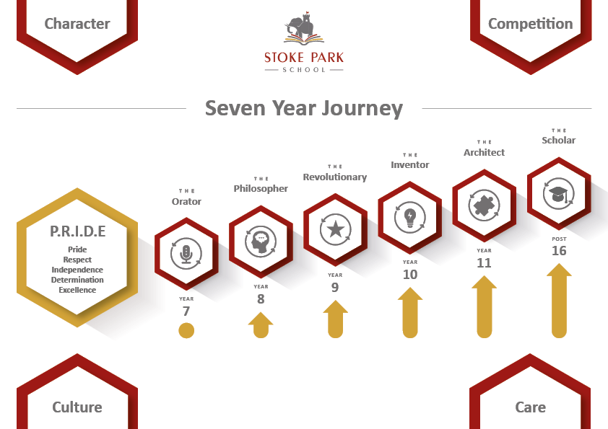

Slide 4

GCSE Exams
All students – English Language, English Literature, Maths, Biology, Chemistry, Physics, History or Geography
Options – Art, Design, Food, Textiles, BTEC Sport, French, RE, Media, Sociology, Drama, Music

Slide 5
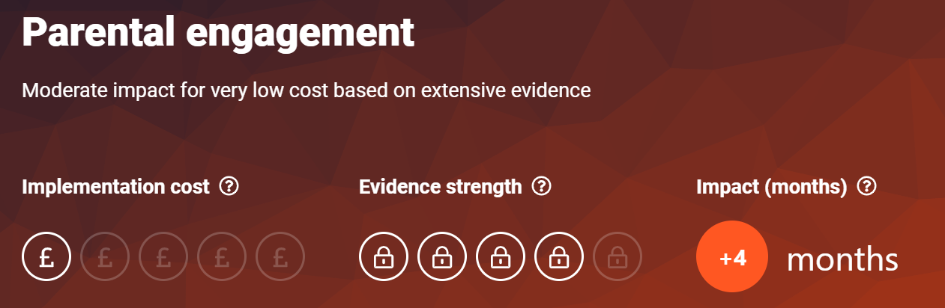
Why your support matters

Slide 6
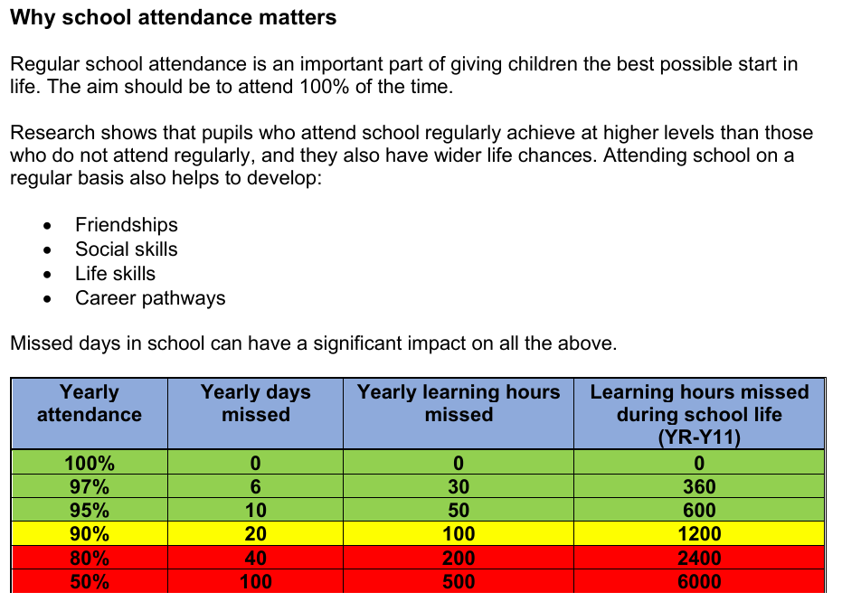
Attendance

Slide 7
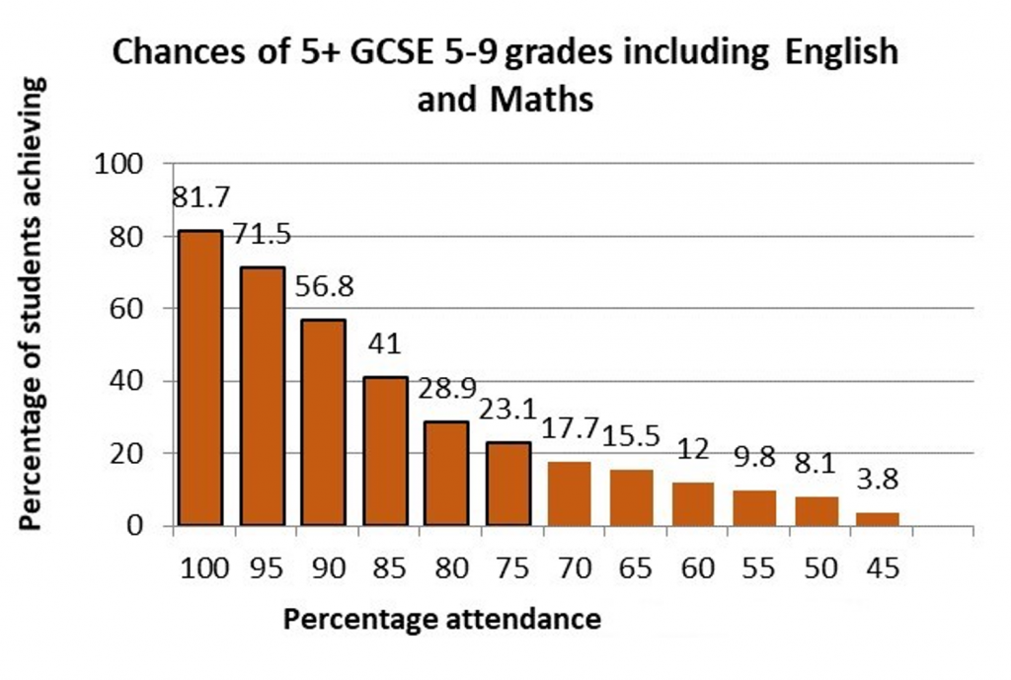
Attendance
“Among pupils with no missed sessions over KS4, 83.7% achieved grades 9 to 4 in English and maths compared to 35.6% of pupils who were persistently absent.”

Slide 8
The Importance of GCSEs
The National Literacy Trust complied a report and research on the UK economy found:
People with poor numeracy skills are more than twice as likely to face unemployment.
Having formally recognised Maths and English qualifications can make the difference when applying for a job or promotion you may want. People with good Maths and English skills earn approximately £2,000 more than those who don’t.
95% of all employment in the UK requires employees to be able to read.
Just under two-thirds of men and three-quarters of women with very low literacy skills have never received a promotion.

Slide 9
KS4 – Broad and Appropriate Courses
Which Allow Students to be Successful
All students should experience a challenging, aspirational curriculum whether it be vocational or academic.
Subjects implement a rigorous curriculum which incorporates, knowledge (both of the subject and the exam specification), accurate assessment and is designed to allow all learners to make progress.
The curriculum at KS4 prepares students not only for their GCSEs but also to be
Post-16 ready whether they follow academic or vocational courses.

Slide 10
Our Core Principles and Values
Students First – young people, staff, leaders, governors and trustees totally focused upon the educational benefit of our pupils and students within a safe and supportive environment.
It’s about learning – young people, staff, leaders, governors and trustees totally focused upon developing and improving the learning of pupils and students underpinned by harmonious and trusting relationships.
No Barriers – no excuses, only support to ensure young people, staff, leaders, governors and trustees maximise the academic achievement of pupils and students whilst enabling them to develop and flourish as well rounded individuals.
Building Brighter Futures

Slide 11
Big decisions
Before we get you thinking about WHAT decisions you are going to make, we want you to know HOW to make the best decisions for yourself.

Slide 13

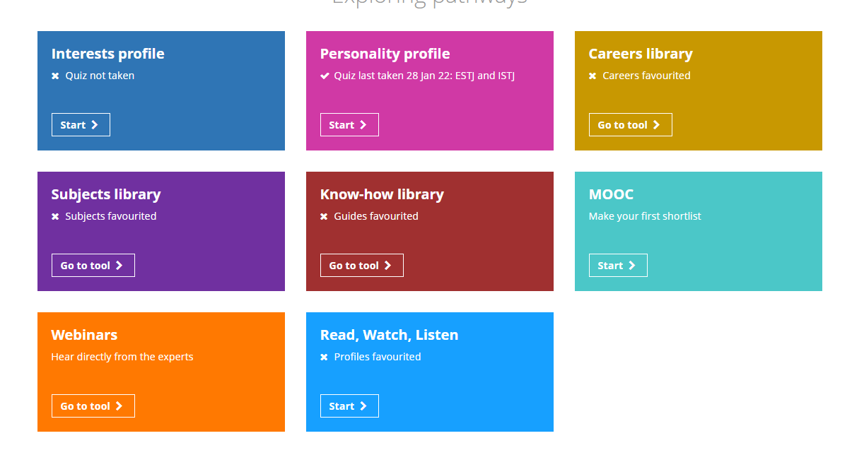
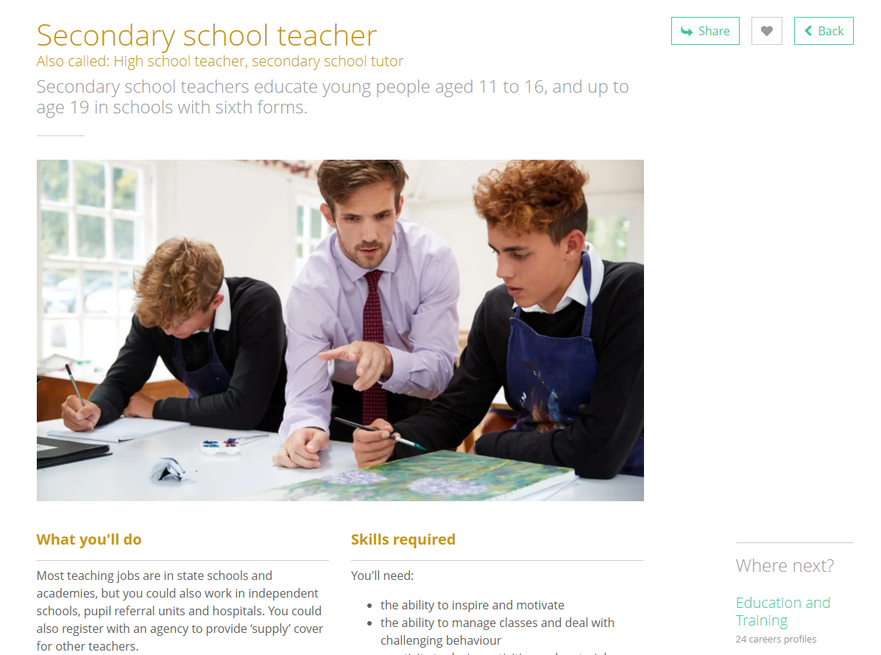
An online careers programme to support students with their future decisions and aspirations
Every student has been given a log in and has full access to this for you to sit down and explore their future options available to them
Supports in a range of different aspects all the way through to Post-16

Slide 14
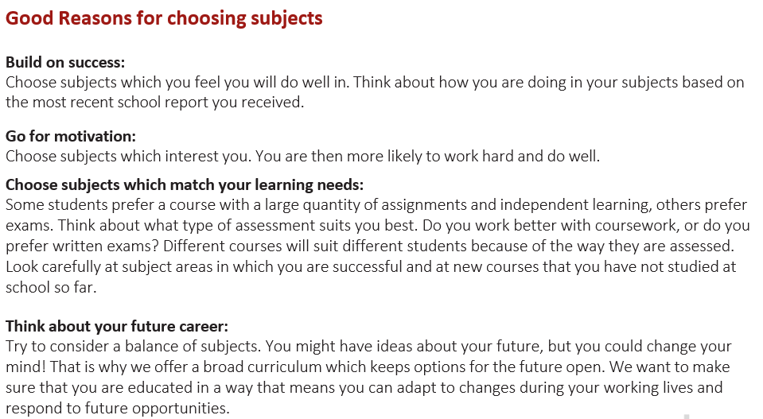

Slide 15
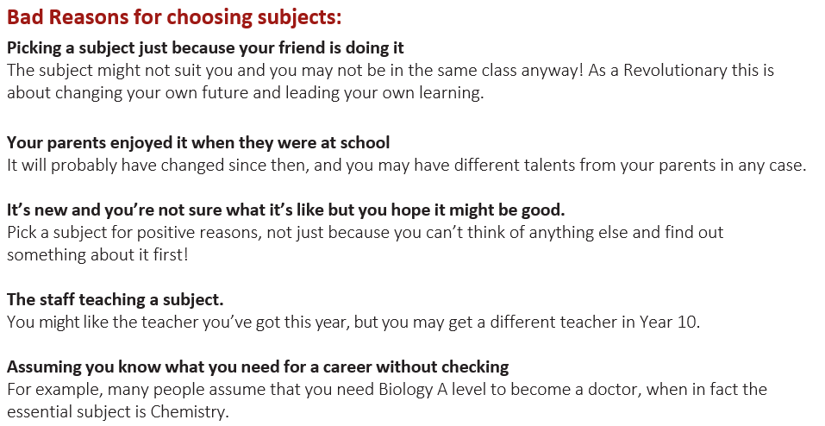

Slide 16
The Process – Key Dates and Information
Year 9 Options Evening live 5:00pm Tuesday 11th February 2025
Watch the Options Videos via the YouTube link. Take your time to watch these and understand the skills and course content of each subject. These are on our school website.
Complete your Option choices via the Forms link. This will be shared on Tuesday 25th February 2025. This must then be completed by Tuesday 25th March 2025.

Slide 17
Choices – An important decision
Choices made for year 10 should be based on enjoyment of a subject and ability in a subject.
No choices made now will be a barrier to future careers or Post-16 choices.

Slide 18
Compulsory Subjects
English Literature
English Language
Mathematics
Combined Science (worth 2 GCSEs)
History OR Geography

Slide 19
Optional Subjects
Students will select a First and a Reserve choice in each option block.
We do try to give students their first choice, however, we cannot guarantee that students will receive their first choice in both option blocks.
Option 1 |  | Option 2
French |  | French
Latin |  | Latin
RE |  | Textiles (cannot be selected with Art)
Art (cannot be selected with Textiles or Design) |  | Music/Music Technology
Drama |  | Computer Science
Food Preparation and Nutrition |  | Sociology
Triple Science (cannot be selected as a Reserve) |  | Design Technology (cannot be selected with Art)
Media Studies |  | BTEC Sport

Slide 20
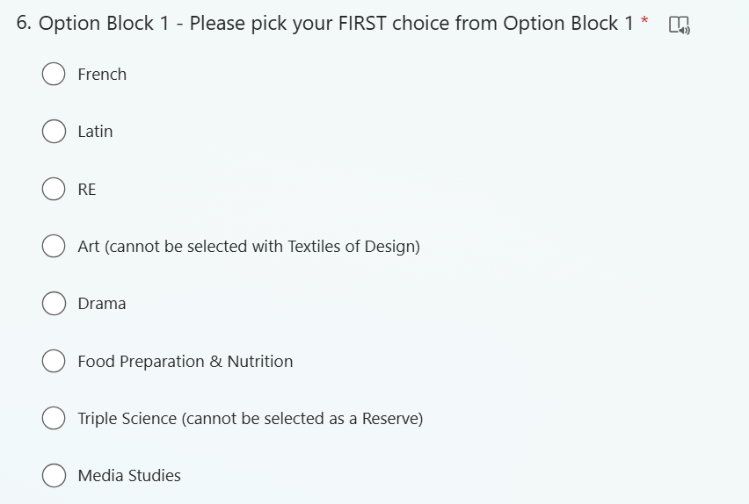
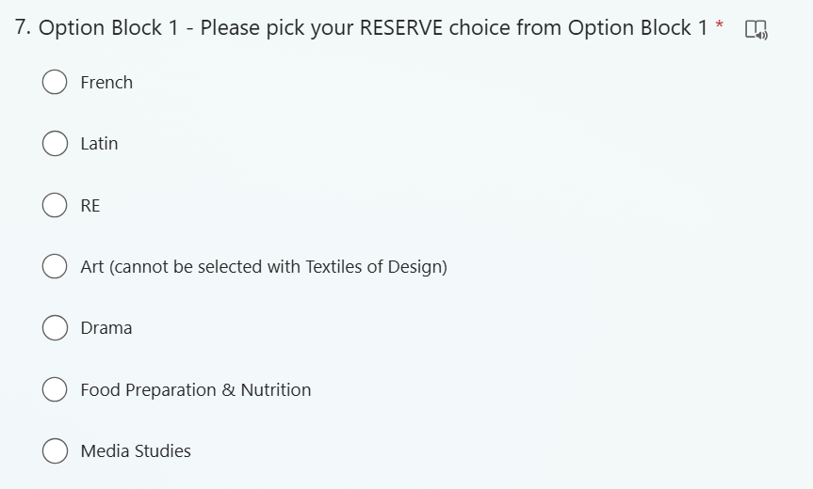
https://forms.office.com/e/77GhGzzWPt

Slide 21
Overlap Subjects
Some subjects are too similar for students to study both.
Combinations which are not allowed are:
Art and Textiles/Design

Slide 22
Popular Subjects/Class Sizes
Some subjects are highly popular and will often be over-selected. Other subjects may have smaller group sizes. We therefore would not recommend selecting any of the below as Reserve options:
Sociology
Design

Slide 23
EBACC Choices
To achieve the EBACC students must also choose French or Latin and achieve grades 5+.
The EBACC is useful for going on to study at University, particularly the top Universities and Russell Group Universities.

Slide 24
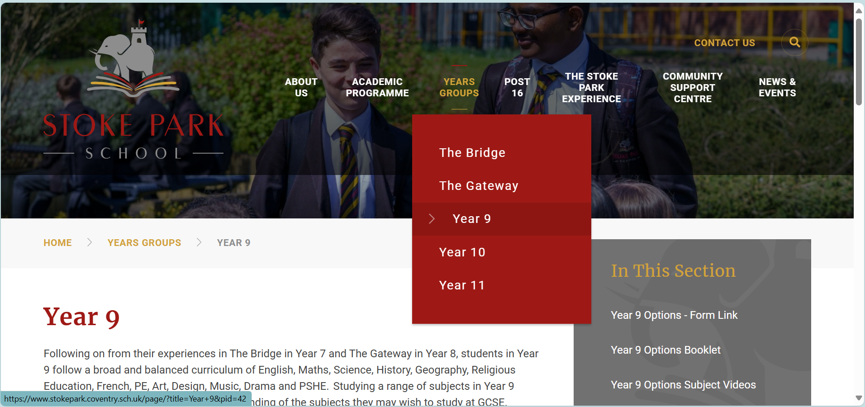
The rest of the evening:
Subject videos are now available to view for students and parents.

